Slide 1
PHOTOELASTIC PROPERTIES OF K₂SO₄ DOPED WITH COPPER
Pavlo Shchepanskyi
V. Y. Stadnyk¹, R. B. Matviiv¹, R.S. Brezvin¹, P.A. Shchepanskyi^{1,2}
¹ Ivan Franko National University of Lviv, Dragomanova St., 19, 79005 Lviv, Ukraine
e-mail: vasylstadnyk@ukr.net
² Jan Dlugosz University in Częstochowa, Al. Armii Krajowej 13/15, 42-200 Czestochowa, Poland
ISPCS'20 – 17.06.2020

Slide 2
AВSO₄ system
A is the alkali-metal ion
B is alkali-metal ion or NH₄ group
K₂SO₄, LiKSO₄, Li₂SO₄, RbNH₄SO₄, LiNH₄SO₄
K₂SO₄
orthorombic
Pnma
860 K
hexagonal
P63/mmc
K₂SO₄
K₂SO₄:Cu²⁺ (1,7 %, 3 %)

Slide 3
Crystal structure
XRPD of K_{1.84(1)}Cu_{0.08(1)}SO₄ compound
Fig. 1.
Atom | Wyckoff position | x | y | z | B_{iso}, Å² | G
K1 | 4c | 0.1727(3) | 1/4 | 0.4112(3) | 1.45(8) | 0.939(4)
K2 | 4c | 0.4894(3) | 1/4 | 0.7020(2) | 0.90(7) | 0.903(4)
S | 4c | 0.2308(3) | 1/4 | 0.0804(3) | 1.70(9) | 1
O1 | 4c | 0.0351(7) | 1/4 | 0.0818(6) | 2.1(2) | 1
O2 | 4c | 0.7927(9) | 1/4 | 0.5626(6) | 2.0(3) | 1
O3 | 8d | 0.3011(6) | 0.0363(7) | 0.1472(4) | 1.7(2) | 1
Cu | 8d | 0.110(7) | 0.083(3) | 0.257(5) | 1.8(2) | 0.040(2)

Slide 4
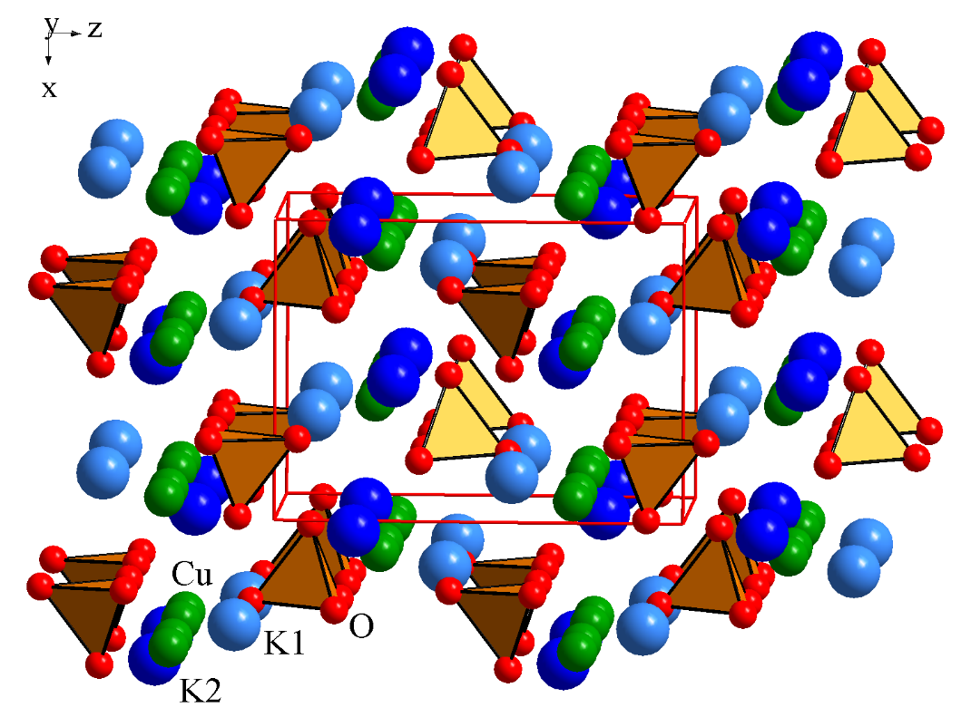
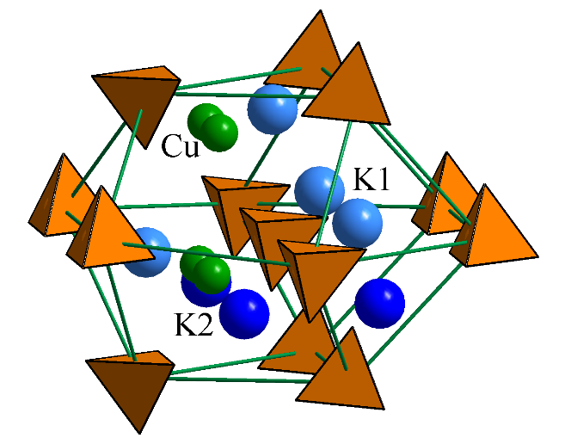
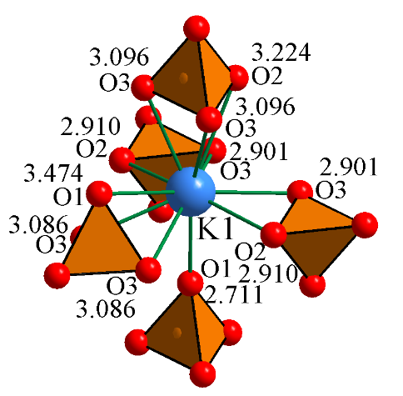
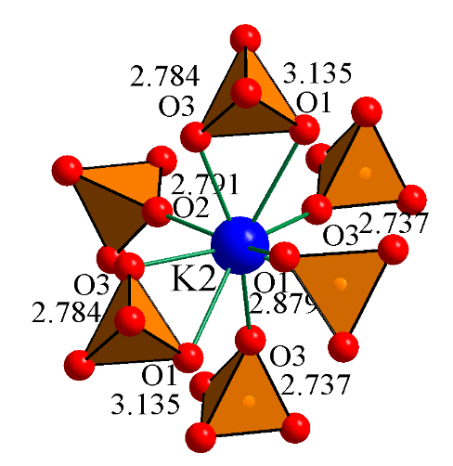
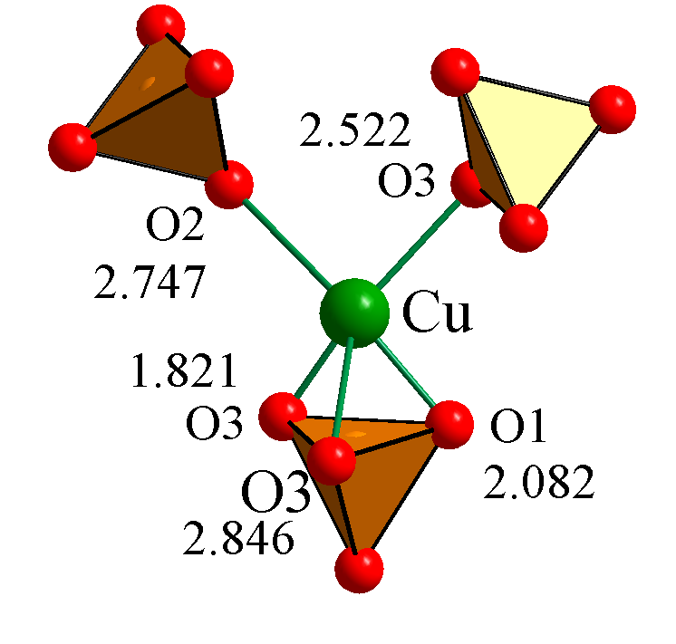
Crystal structure
Fig. 2. Stacking of metal component atoms and SO₄ tetrahedra in the structure of K₂SO₄:Cu²⁺ crystals
Fig. 3. Second oordination environment of the anionic
group in the structure of K₂SO₄:Cu²⁺ crystals.
Fig. 4. Coordination environment and interatomic distances of Me-O in the structure of K₂SO₄:Cu²⁺ crystals.

Slide 5
Refractive parameters
 | B_{i}, 10⁻⁶ nm⁻² | B_{i}′, 10⁻⁹ nm⁻² | λ_{0i}, nm | R_{i},10⁻⁶ m³ | α_{i}, 10⁻²⁴ cm³
X (pure) | 148.033 | 6.738 | 90.322 | 19.217 | 7.622
X (Cu wt 1.7%) | 142.961 | 4.610 | 91.734 | 19.185 | 7.609
X (Cu wt 3%) | 135.432 | 2.195 | 94.046 | 19.158 | 7.599
Y (pure) | 147.527 | 6.137 | 90.329 | 19.164 | 7.601
Y (Cu wt 1.7%) | 142.757 | 3.742 | 91.673 | 19.144 | 7.593
Y (Cu wt 3%) | 134.921 | 1.504 | 94.096 | 19.125 | 7,586
Z (pure) | 146.175 | 4.576 | 91.130 | 19.295 | 7.653
Z (Cu wt 1.7%) | 140.231 | 2.217 | 92.859 | 19.269 | 7.643
Z (Cu wt 3%) | 134.597 | 0.608 | 94.657 | 19.263 | 7.640
 | a, Å | b, Å | c, Å | V, Å³ | density ρ, g/cm³
pure | 7.4776 | 5.7704 | 10.0712 | 434.56 | 2.66
Cu wt 1.7% | 7.4773 | 5.7716 | 10.0738 | 434.74 | 2.649
Cu wt 3.0% | 7.4777 | 5.7717 | 10.0735 | 434.76 | 2.641
 | n₁ | n₂ | n₃ | n₄ | n₅ | n₆
Pure crystal | 1.4959 | 1.4922 | 1.4934 | 1.4928 | 1.4946 | 1.4940
Cu wt = 1.7% | 1.4950 | 1.4913 | 1.4924 | 1.4918 | 1.4937 | 1.4931
Cu wt = 3.0% | 1.4944 | 1.4902 | 1.4913 | 1.4907 | 1.4928 | 1.4923

Slide 6
Piezo-optical coefficients
1
Spectral dependences of the combined piezo-optical constants of K₂SO₄ (Cu wt 3%) crystals at room temperature : 1 – π₁₂⁰; 2 – π₂₃⁰; 3 – π₃₁⁰; 4 – π₂₁⁰; 5 – π₃₂⁰; 6 – π₁₃⁰

Slide 7
Piezo-optical coefficients
Pockels relations n_{i}³π_{ii} – n_{j}³π_{ji} = 2(π_{im}⁰σ_{m} – s₁₂(n_{j} – n_{i})σ_{m}) (i, j, k = 1, 2, 3)
2
Rotational–shift components
3
4
р_{in} = π_{im}C_{mn},
p₁₁ = π₁₁ С₁₁ + π₁₂ С₁₂ + π₁₃ С₁₃,
p₁₂ = π ₁₁ С₁₂ + π₁₂ С₂₂ + π₁₃ С₃₂,
p₁₃ = π ₁₁ С₁₃ + π₁₂ С₂₃ + π₁₃ С₃₃,
p₄₄ = π₄₄ С₄₄
5
6
7
 | π₁₁ | π₁₂ | π₁₃ | π₂₁ | π₂₂ | π₂₃ | π₃₁ | π₃₂ | π₃₃ | π₄₄ | π₅₅ | π₆₆
1,7 % | 2.1 | 2.7 | 0.7 | –0.8 | 1.0 | –1.8 | 2.0 | 3.2 | 2.6 | 7.3 | 1.8 | –2.6
3,0 % | 2.0 | 2.6 | 0.7 | –0.7 | 1.0 | –1.7 | 2.0 | 3.1 | 2.5 | 7.3 | 1.7 | –2.4
 | р₁₁ | р₁₂ | р₁₃ | р₂₁ | р₂₂ | р₂₃ | р₃₁ | р₃₂ | р₃₃ | р₄₄ | р₅₅ | р₆₆
1,7 % | 0.13 | 0.21 | 0.13 | 0.05 | 0.17 | 0.04 | 0.22 | 0.28 | 0.15 | 0.02 | 0.03 | –0.07
3,0 % | 0.12 | 0.20 | 0.11 | 0.04 | 0.15 | 0.03 | 0.20 | 0.26 | 0.14 | 0.01 | 0.02 | –0.06

Slide 8
Acoustooptical efficiency
8
ρ = 2660 kg/m³
max(p_{i}) = р₃₂ n₃ = 1.4934
C_{ijkl}m_{j}m_{k} = ρV ²g_{l}
C_{ijkl} – the components of the elastic stiffness tensor; m_{j}, m_{k} are the unit vector components of the wave normal component; g_{l} are the unit vector components of the transversal wave
V₂ = 4292 m/s.
9
М₂ = 4.8×10^{–15} s³/kg.

Slide 9
Conclusions
The spectral dependences of the absolute piezooptic constants are calculated using the experimentally obtained spectral dependences of the birefringence of Cu-doped potassium sulfate crystals under the action of uniaxial stresses
The matrix of elastooptic coefficients p_{in} of these crystals is filled using the values of elastic stiffness coefficients and absolute piezooptic coefficients
The elastooptical effect as well as the piezooptical effect is quite noticeable in doped potassium sulfate crystals
The highest values of the p_{in} coefficients are at the range from 0.20 to 0.30.
The maximum values of the acoustooptical coefficient of Cu-doped potassium sulfate crystals are nearly an order of magnitude higher than that of quartz and strontium borate, which are suitable for AO light modulation at the ultraviolet spectral range

Slide 10
Thank you for attention!

