Slide 1


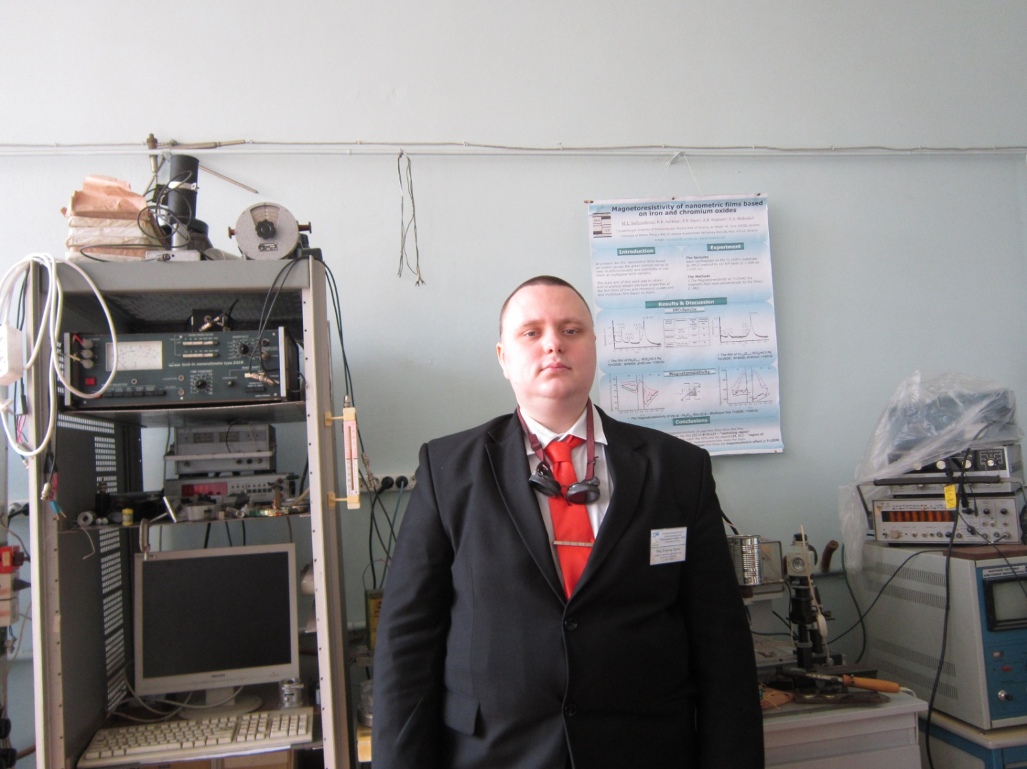

PASSIVATION OF SiGe SURFACES BY COLLAPSING BUBBLES AT THE SURFACE/REACTIVE ETCHANT INTERFACE
Shmid V, A. Podolian, А. Nadtochiy, O. Korotchenkov
Reporter: Shmid V
shmdvi@gmail.com

Slide 2
Introduction
Depositing a passivation ﬁlm on Si/Ge surfaces is of great interest for electronics and photovoltaics.
However, standard high-temperature passivation steps, based on oxidizing at ~ 1000 °C, degrade the carrier lifetime. To improve the lifetimes in Si/Ge, here we use sonochemical treatments in chloroform (CHCl3) and dichloromethane (CH2Cl2). It is suggested that these carbon sources are decomposed into hydrocarbon chains due to extreme conditions in the solvents and at the etchant/solid interfaces, as temperatures of ~ 5000°C, pressures of ~ 50 MPa and cooling rates greater than 109 K/s are achieved after the growth and following collapse of cavitation bubbles [1].
[1] K. S. Suslick, Science, 247, 1439-1445 (1990).

Slide 3
XRD results
The parameter of the Si unit cell (determined by the position of the diffraction maximum components) is equal to а = 0.54299 nm, which has only the 8ˑ10 ^{– 5} nm difference from the tabular value of this parameter (а = 0.54307 nm). Such differences are consistent with both the experimental errors in position determination and may be due to the effect of dopants.

Slide 4
SPV
In this work, after each treatment step of the sample surface, the surface photovoltage (SPV) decay curves were measured. In every case, the SPV decay time and the amplitude value of the SPV signal undergo significant changes.

Slide 5
SPV
The resulting fitting of the parameters is shown in table

Slide 6
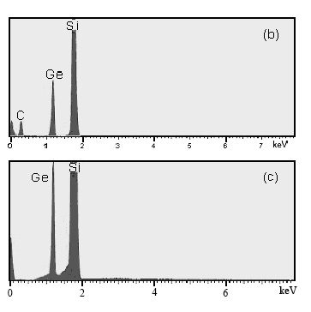
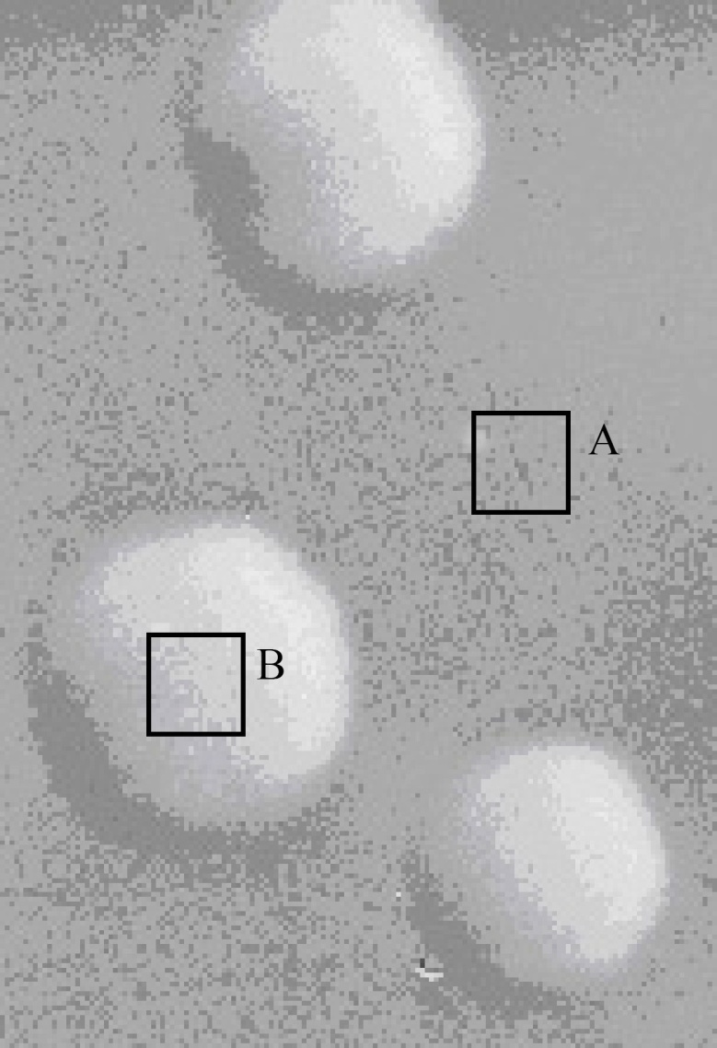
SEM image (left) and EDX spectra (right) in SiGe
(a)
(a) SEM image taken on the Si/Ge surface; (b) and (c) EDX spectra measured in the surface areas A and B marked in (a)

Slide 7
CONCLUSIONS
SPV signal in Si can be significantly enhanced due to sonochemical treatments in dichloromethane.Similar effect can be observed for SiGe surfaces with a smaller enhancement.
An order of magnitude larger SPV signal is observed in Si, whereas a 50 % increase in the amplitude is reproduced in SiGe.
It is suggested that dichloromethane acts as a carbon source, so that sonochemically decomposed carbon atoms can effectively passivate silicon dangling bonds. The carbon involvement is verified by using electron microscopy (SEM) and energy-dispersive X-ray (EDX) spectroscopy.
It is furthermore believed that such a sonochemical treatment step would be beneficial for the surface passivation in Si - and SiGe - based solar cell fabrication processes.

Slide 8
Thanks for your attention

