Slide 1
quantum-topological analysis of stock market data
Solomiia Leno
Faculty of Applied Sciences,
Ukrainian Catholic University

Slide 2
aim of research
implement quantum algorithm for detecting possible time allocations of stock market crashes using topological data analysis on IBM Quantum Experience API for quantum computers

Slide 3
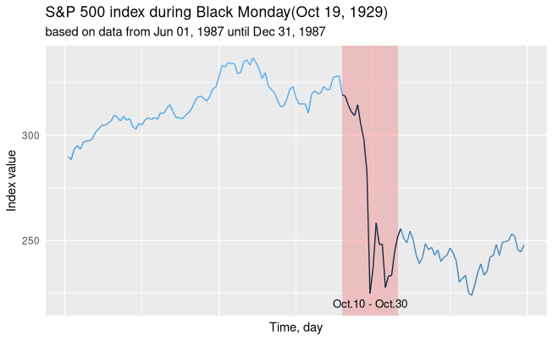
stock market crash
fast decrease in value of stock market productivity index
(stock price, industrial average etc.) by 10 і > %
Figure 1. Stock market crash definition:
value of S&P 500 Industrial Average during crash on Black Monday

Slide 4
topological data analysis
an approach to the analysis of topologically structured data
TDA provides a general framework to analyze such data in a manner that is insensitive to the particular metric chosen and provides dimensionality reduction
such approaches manage well the highly dimensioned or noisy data

Slide 5
algorithm pipeline
data averaging
2. Takens’ embedding
3. persistent homology
4. Betti numbers calculations

Slide 6
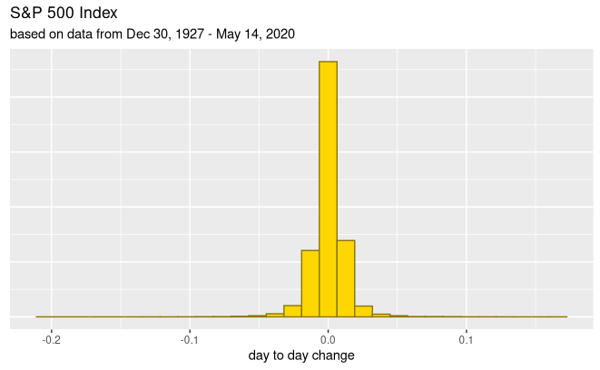
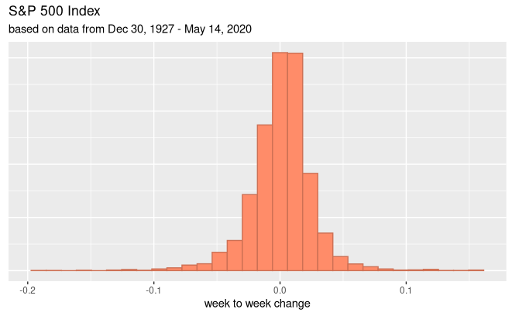
data averaging: motivation
Figure 2. Data averaging motivation:
left - histogram on values of day-to-day change of Close value of S&P Industrial Average,
right - on values of weekly changes of Close value of S&P Industrial Average

Slide 7
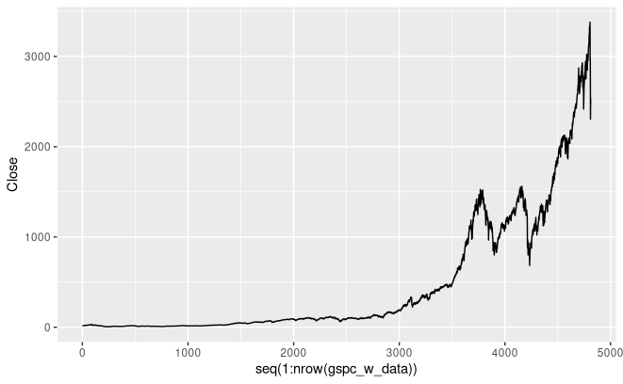
data cloud: motivation
* picture from [2]
2 dimensions
3 and more dimensions
Figure 3. Shape of data:
left - traditional time series representation of stock price data,
right - representation of data on S&P 500 Industrial Average as 3-dimensional data cloud

Slide 8
Takens embedding
width = τ * d
step δ
Figure 4. Takens’ embedding visualisation with sliding window

Slide 9
Takens embedding
τ - time delay
d - embedding dimension

Slide 10
persistent homology
* picture from [2]
persistence diagram
Figure 5. Persistent homology:
left - data cloud, right - corresponding persistence diagram

Slide 11
Betti numbers calculation
*pictures from [2]
Figure 6. Betti curve
left - Betti curve, right - Betti curve after normalization with set threshold of market crash

Slide 12
why quantum?
one can create 2^{n} topologically different structures from data represented as n-element vector
n classical bits = log₂ n quantum bits
thus, all 2^{n} possible topological structures can be described with only n-bit quantum state

Slide 13
why quantum?
time complexity
due parallel access to qRAM one can achieve
O(n³) vs. O(2^{2n})
*numbers by [1]

Slide 14
quantum algorithm pipeline
data preparation: classical computer
1.1. data averaging
1.2. Takens’ embedding
embedding dimension = 2^{n}
1.3. configuration data for quantum computer

Slide 15
quantum algorithm pipeline
Figure 7. Data representation within quantum computer pipeline

Slide 16
quantum algorithm
data preparation: quantum computer
set quantum bits to needed quantum states using U3 gate
calculate pairwise distances between data points denoted as quantum states

Slide 17
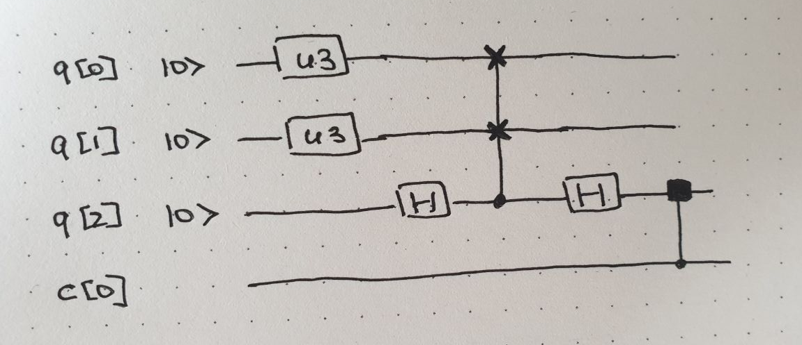
quantum algorithm pipeline
! IBM Q API does not provide functional needed to create custom 3-bit gates
Figure 8. Circuit for calculating the distance between two data points represented as quantum states of q[0] and q[1] with q[2] being the control bit

Slide 18
quantum algorithm pipeline
2. simplicial complex сonstruction
Grover’s search
Figure 9. Circuit for implementation of Grover’s search algorithm with 2 quantum bits, searched state - 00.
Source: IBM Q tutorial: Grover’s algorithm

Slide 19
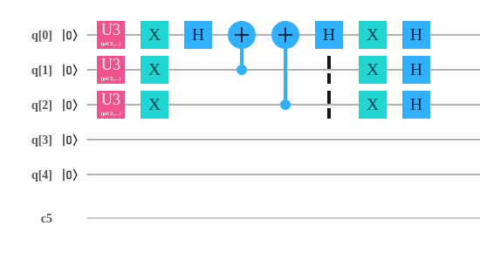
quantum algorithm pipeline
Figure 10. Circuit for implementation of Grover’s search algorithm with 3 quantum bits and multiple correct answers.

Slide 20
quantum algorithm pipeline
3. persistent homology
3.1. project |s_{k}> onto vector space W_{k} spanned by |s_{k}(l)>
Figure 11. Operator of projection of |s_{k}> onto its boundary map space W_{k}

Slide 21
quantum algorithm pipeline
3.2. construct Hermitian matrix B_{k}
Figure 12. General look of Hermitian matrix B_{k}

Slide 22
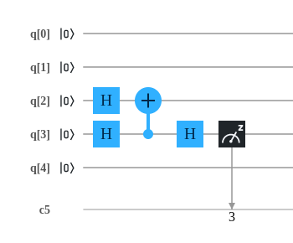
quantum algorithm pipeline
3.3. quantum phase estimation on B_{k}
4. data post-processing: classical computer
Figure 12. Circuit for implementation of quantum phase algorithm with
q[2] and q[3] being set to quantum state denoting B_{k}

Slide 23
implementation details
all circuits were developed by using
IBM Quantum Experience API

Slide 24
data and testing
The P&S 500 Industrial Average
Wall Street crash of 1929
Black Monday - October 19, 1987
The crisis of 2008-2009
Coronavirus stock market crash of 2020

Slide 25
conclusions
quantum computations is an interesting field for research and further improvements but with current development of quantum computers it proves itself useful only a small number of real-life applicable problems

Slide 26
references
[1] Lloyd, Seth & Garnerone, Silvano & Zanardi, Paolo.
(2014). Quantum algorithms for topological and
geometric analysis of big data.
[2] Detecting stock market crashes with topological
data analysis
[3] Vakarchuk I. Quantum mechanics.
Lviv State University of Ivan Franko; 1998. 614 p.
[4] Dawid Kopczyk. (2018). Quantum machine learning
for data scientists

